Slide 1

CODE REFRACTORING
AND
BUG FIXING

Slide 2
About me
Name: Kishore Reddy Alavala
Background:
B-tech in Computer Science and Engineering
Why you want to learn Data Science:
Since data is being generated everywhere, which is essential for analysis and the creation of insights. In the upcoming years, artificial intelligence and data science will likewise dominate the global scene. I decided on data science because I'm interested in this field, eager to learn new things, and eager to create models.
Any work experience:
Fresher
LinkedIn :
https://www.linkedin.com/in/kishore-reddy-alavala-29698a2a4/
Github:
https://github.com/kishorerddy

Slide 3
Introduction
The task is about debugging and refining a Note Taking Application developed using Python, Flask, and HTML. The task presents a scenario where a team of data scientists embarked on a mission to create a Note Taking Application but encountered challenges due to their limited experience in backend development. As a result, the application failed to function seamlessly, prompting the need for a proficient backend developer to rectify the existing codebase.
The primary objective of this task is to identify and address the issues within the Note Taking Application's codebase, ensuring that the application functions as intended. Rather than starting from scratch, the focus is on analyzing the existing code, diagnosing the problems, and implementing necessary changes to make the application fully functional.

Slide 4
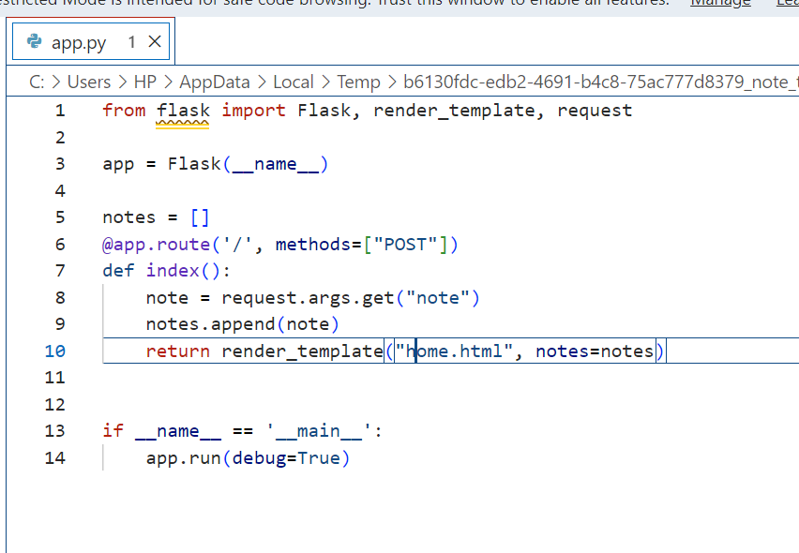
Here, it is using the requests.args.get method to get the note from the data, but this method is used to get data from the query string of the URL , not from the form data.
When the URL is accessed, it is calling only POST request.
Since there is not any template, it also shows template not found error when we try to execute it.

Slide 5
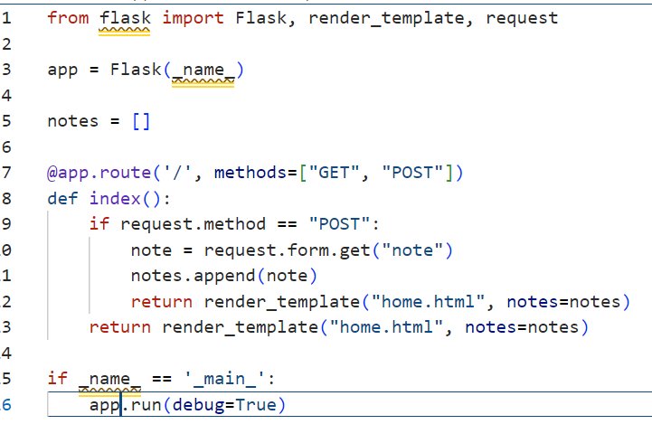
Here, instead of using requests.args.get method, to get the note from the data we used requests.form.get method.
When the URL is accessed, it has to call both GET and POST requests.

Slide 6
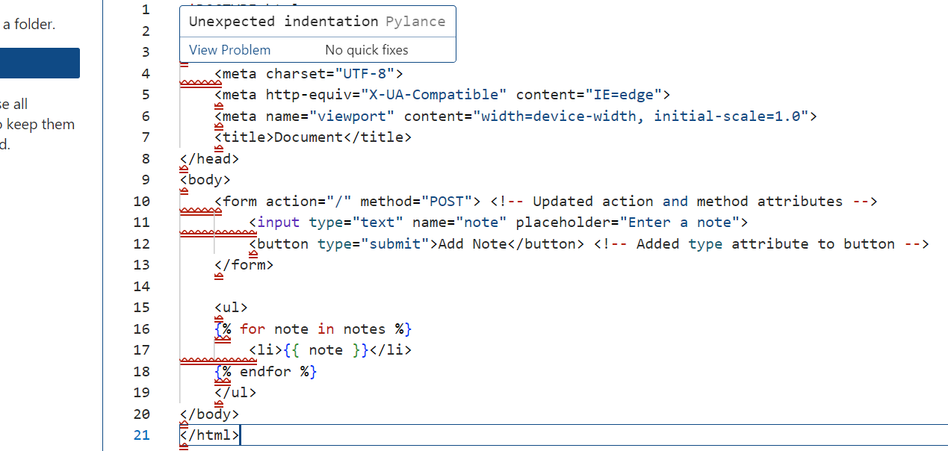
It is the HTML code which serves as a template for the frontend of Note taking Application.
<form> element allows users to input a note and submit it to the server.
Method=‘POST’ attribute indicates that the form data should be sent to the server using the POST method.
Placeholder=“Enter a note” allows the user on what to enter in the input field.
<button> element serves as the submit button for the form.
Below the form, an unordered list <ul> is used to display the list of notes.

Slide 7
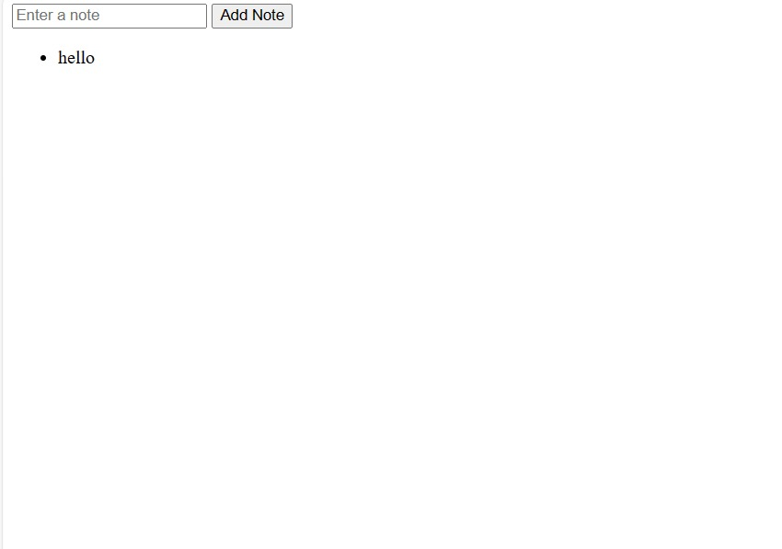
When we type a note into text box and select “Add Note” the note is taken and an unordered list is created. As we continue to add and enter notes, an unordered list of notes will be generated and shown below

Slide 8

THANK YOU

